Slide 1

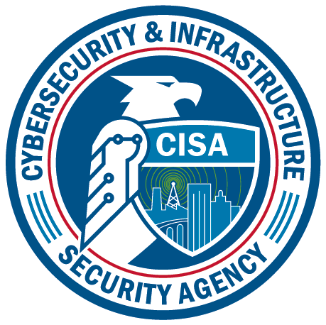
Cybersecurity Awareness Month 2023 How to stay safe online

Slide 2
Cybersecurity Awareness Month
Launched in 2004
Co-managed by the Cybersecurity and Infrastructure Security Agency (CISA) and the National Cybersecurity Alliance (NCA)
Collaborative effort between government and industry to raise cybersecurity awareness
Ensures that everyone has the resources they need to be safe and secure online.

Slide 3
October is Cybersecurity Awareness Month

Slide 4

Theme

Slide 5


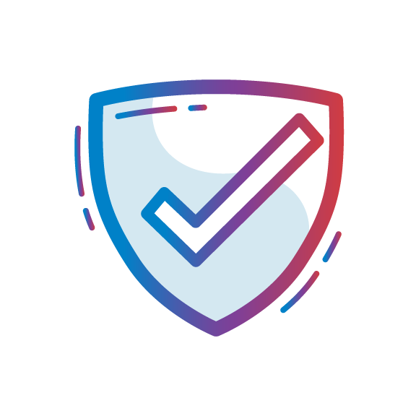

Overall Campaign
Goal
Tone
Take actionable steps to stay safe online
Positive
Approachable
Simple
Back to basics

Slide 6
What is Cybersecurity?
Defined as "the protection of computer systems and networks from attacks by malicious actors that may result in unauthorized information disclosure, theft of, or damage to hardware, software, or data..."
Wherever there is technology, there needs to be cybersecurity.

Slide 7

Why is it Important?
Implementing cybersecurity best practices is important for individuals as well as organizations of all sizes to protect personal, financial and sensitive information.
For both government and private entities, developing and implementing tailored cybersecurity plans and processes is key to protecting and maintaining business operations.

Slide 8
Feelings Toward Cybersecurity
78% of people consider staying secure online a priority
34% noted they often feel overwhelmed by information and, as a result, minimize their online actions
46% felt frustrated while staying secure online
39% of users trying to keep safe felt information on how to stay secure online is confusing
Findings from Oh Behave! The Annual Cybersecurity Attitudes and Behaviors Report 2022

Slide 9
Our Online Behaviors
Only 33% of individuals create unique passwords for all accounts
Only 18% of individuals have downloaded a password manager
43% of respondents have never heard of multifactor authentication (MFA)
Out of the 57% of the participants who had heard about it:
79% applied it at least once and 94% of them reporting that they were still using MFA
92% of respondents took action after a security training
58% say they are better at recognizing phishing
45% started using strong and unique passwords
40% started using MFA
40% started regularly installing software updates
Findings from Oh Behave! The Annual Cybersecurity Attitudes and Behaviors Report 2022

Slide 10



4 Easy Ways to Stay Safe Online
Use Strong Passwords and a Password Manager ​
Turn on Multifactor Authentication ​
Recognize and Report Phishing Attacks​
Update Your Software​

Slide 11
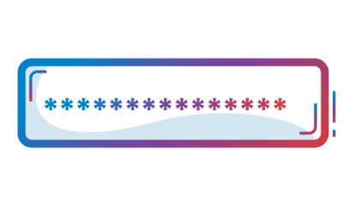
Use Strong Passwords
CREATE STRONG PASSWORDS:
Long
At least 16 characters
Unique
NEVER reuse passwords
Complex
Upper- and lower-case letters
Numbers
Special characters
Spaces

Slide 12
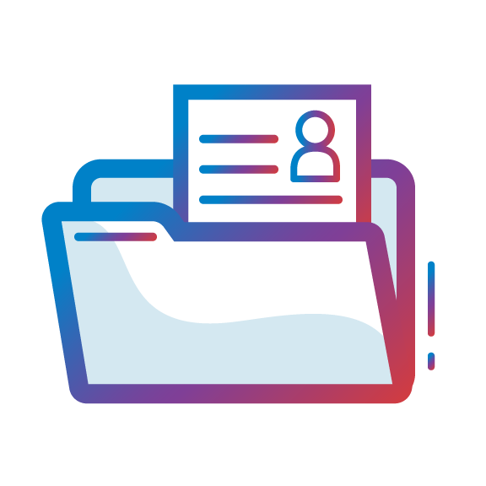
Use a Password Manager
WHY USE A PASSWORD MANAGER?
Stores your passwords
Alerts you of duplicate passwords
Generates strong new passwords
Some automatically fill your login credentials into website to make sign-in easy
Encryption ensures that password managers never "know" what your passwords are, keeping them safe from cyber attacks.

Slide 13
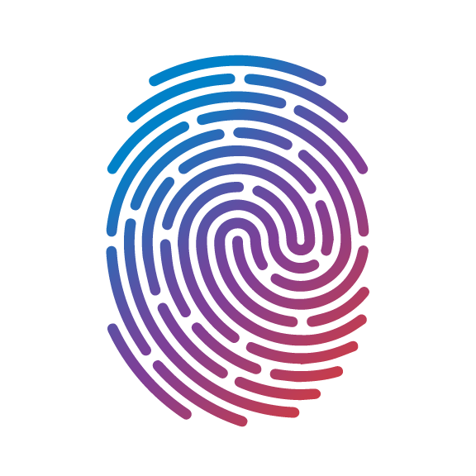
Turn on Multifactor Authentication
WHAT IS IT?
A code sent to your phone or email
An authenticator app
A security key
Biometrics
Fingerprint
Facial recognition

Slide 14

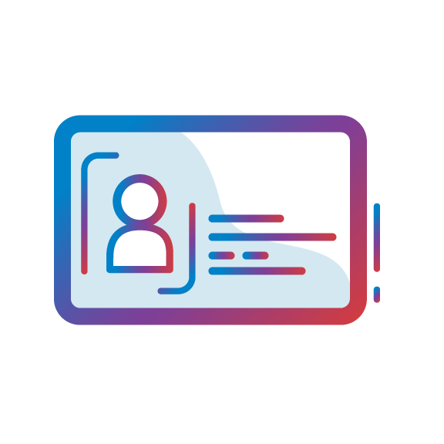
Turn on Multifactor Authentication
WHERE SHOULD YOU USE MFA?
Email
Accounts with financial information
Ex: Online store
Accounts with personal information
Ex: Social media

Slide 15
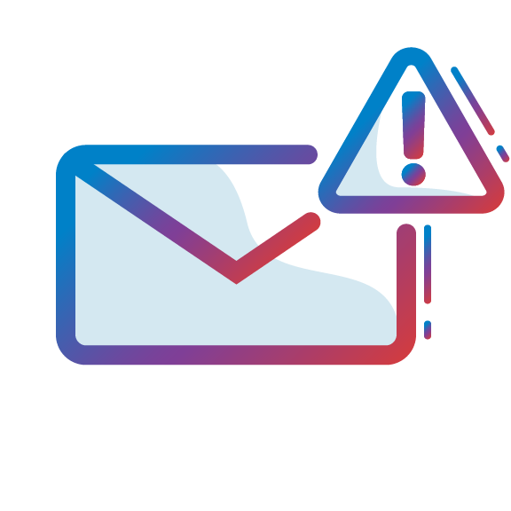
Recognize and Report Phishing
A tone that’s urgent or makes you scared​
"Click this link immediately or your account will be closed"​
Bad spellings, bad grammar​
Requests to send personal info​
Sender email address doesn’t match the company it’s coming from​
Ex: Amazon.com vs. Amaz0n.com​
An email you weren't expecting
PHISHING RED FLAGS:

Slide 16

Recognize and Report Phishing
WHAT TO DO
Do NOT
Do
Don't click any links
Don't click any attachments
Don't send personal info
Verify
Contact that person directly if it's someone you know
Report it to your IT department or email/phone provider
DELETE IT

Slide 17

Update Your Software
WHY?
Updates ensure your devices and apps are protected from the latest threats
Don't click "remind me later", it could leave you vulnerable to cyber threats
Automatic updates are the easiest way to stay secure

Slide 18

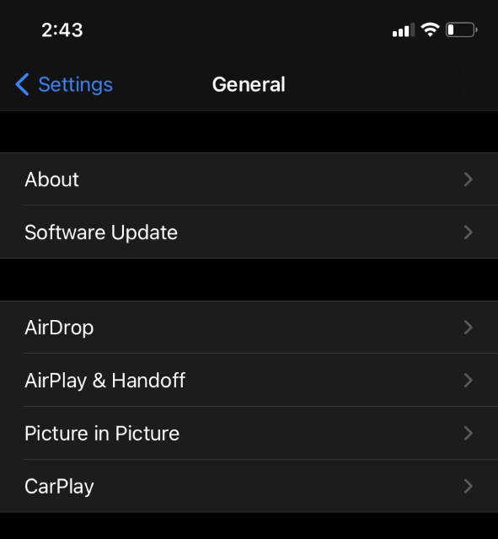
Update Your Software
WHERE TO FIND AVAILABLE UPDATES
Check for notifications to your phone or computer
Look in your phone, browser or app settings
Check the upper corner of your browser for any alerts

Slide 19

Ways to Get Involved
AT WORK
Publicize resources and activities
Intranet
Website
Emails to employees/customers
Promotions
Discounts
Giveaways
Hold a contest
Phishing simulation
Poster contest
AT HOME
Share helpful tips and resources
Kids
Parents
Friends
Hold a family “tech talk”
Discuss how each family member can protect their devices, accounts, and personal information.
Create a culture of security in your family

Slide 20
Ways to Get Involved Cont.
IN YOUR COMMUNITY
Volunteer to teach others in your community
Reach out to
Your kid's school
A library/community center
Senior center
Place of worship
ONLINE
Join on the conversation on social media using
#CybersecurityAwarenessMonth
#SecureOurWorld

Slide 21
Building a Strong Cybersecurity Culture
Use basic cybersecurity training. This helps familiarize staff with cybersecurity concepts and activities associated with implementing cybersecurity best practices.
Identify available cybersecurity training resources. Cybersecurity training resources—on topics like phishing and good email practices—are available through professional association, educational institutions, as well as private sector and government sources.
Stay current on cybersecurity events and incidents. This helps identify lessons learned and helps to maintain vigilance and agility to cybersecurity trends.
Encourage employees to make good choices online and learn about risks like phishing and business email compromise.

Slide 22

Additional Resources
CISA
Report a Cyber Issue
Secure by Design
Cross-Sector Cybersecurity Performance Goals
Cyber Resource Hub
Cybersecurity Training & Exercises
CISA YouTube Channel
NCA
Resources and Guides
Videos and On-Demand Webinars

Slide 23
Get in Touch
CISA
cisa.gov/cybersecurity-awareness-month
AwarenessCampaigns@cisa.dhs.gov
NCA
staysafeonline.org
info@staysafeonline.org

